Slide 1

Real Time Road monitoring System

Slide 2
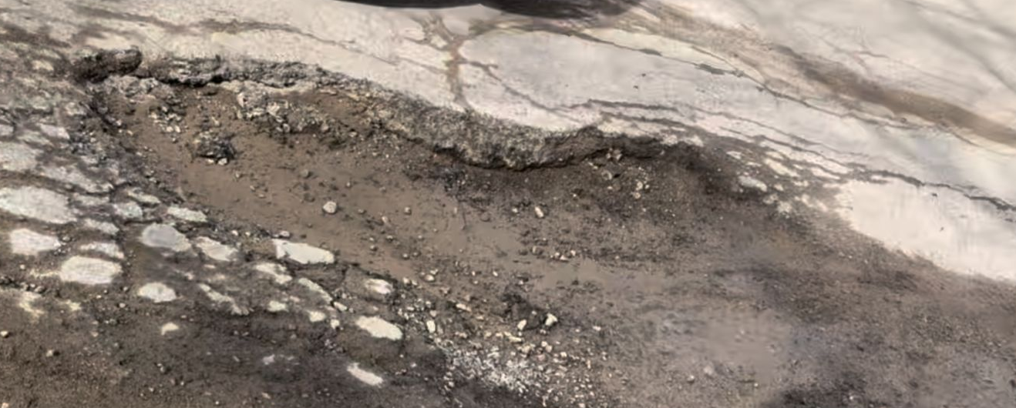
Client Issues
Increasing potholes & congestion
Seasonal data collection
Manual road assessment
Lack of real time insights
Absence of real-time data on traffic flow and road condition
Need for improved data collection systems
Fig. 1: Pothole
Notes:
Mubashir:
As city expands many road problems such as potholes and traffic congestion increase, and it becomes increasingly difficult to manage
Current systems are centralized
Data collection is done seasonally
lack real time insight
We seek to develop real – time distributed solution so that municipalities may be able to augment their data collection systems

Slide 3
Objectives
Read real time data from car’s Controller Area Network (CAN) bus
Use CAN bus data to determine road conditions
Use sensors to sense pothole on road
Send pothole and CAN bus data to internet for data analysis
Notes:
Sarmad:
Briefly explain can bus, communication protocol like USB, used in a car to allow different sensors and components to talk to each other
Read can bus to determine when a vehicle is slipping
Use sensors to determine if a vehicle has gone over a pothole
Send the pothole and can bus data to the internet for data analysis

Slide 4
Design specifications
Data can be sent over cellular network (4G) to a central location (backend server)
Detect pothole based on suspension of the vehicle (80% accuracy)
Read a vehicle’s speed and wheel slip (ABS) data over the On-board diagnostics port (OBD-II) in real time
Get real time location (GPS) of the vehicle
Determine icy road conditions
Use wireless communication protocol to get data from sensors mounted on a car’s suspension
Implement a real time operating system (RTOS) on an inexpensive microcontroller
Power peripherals using batteries
Display Data on website with a heatmap
Notes:
Mubashir: - Briefly mention each point

Slide 5
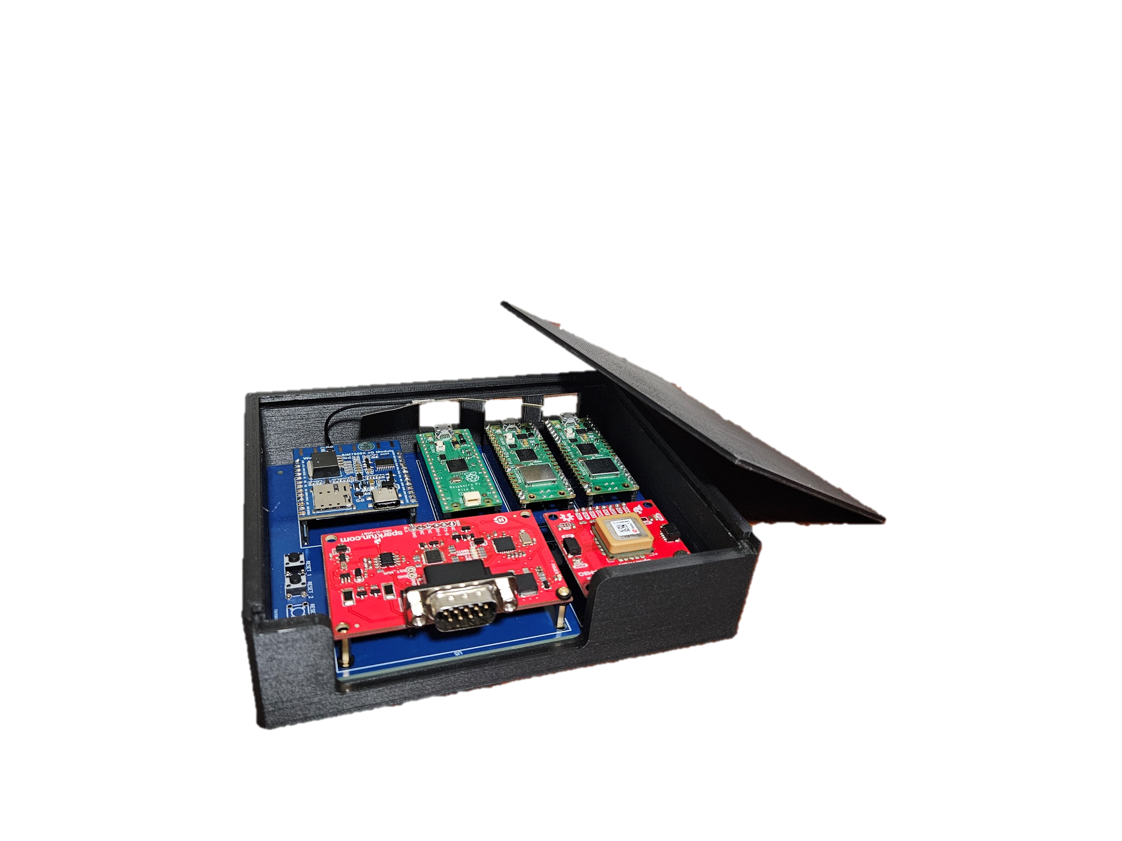
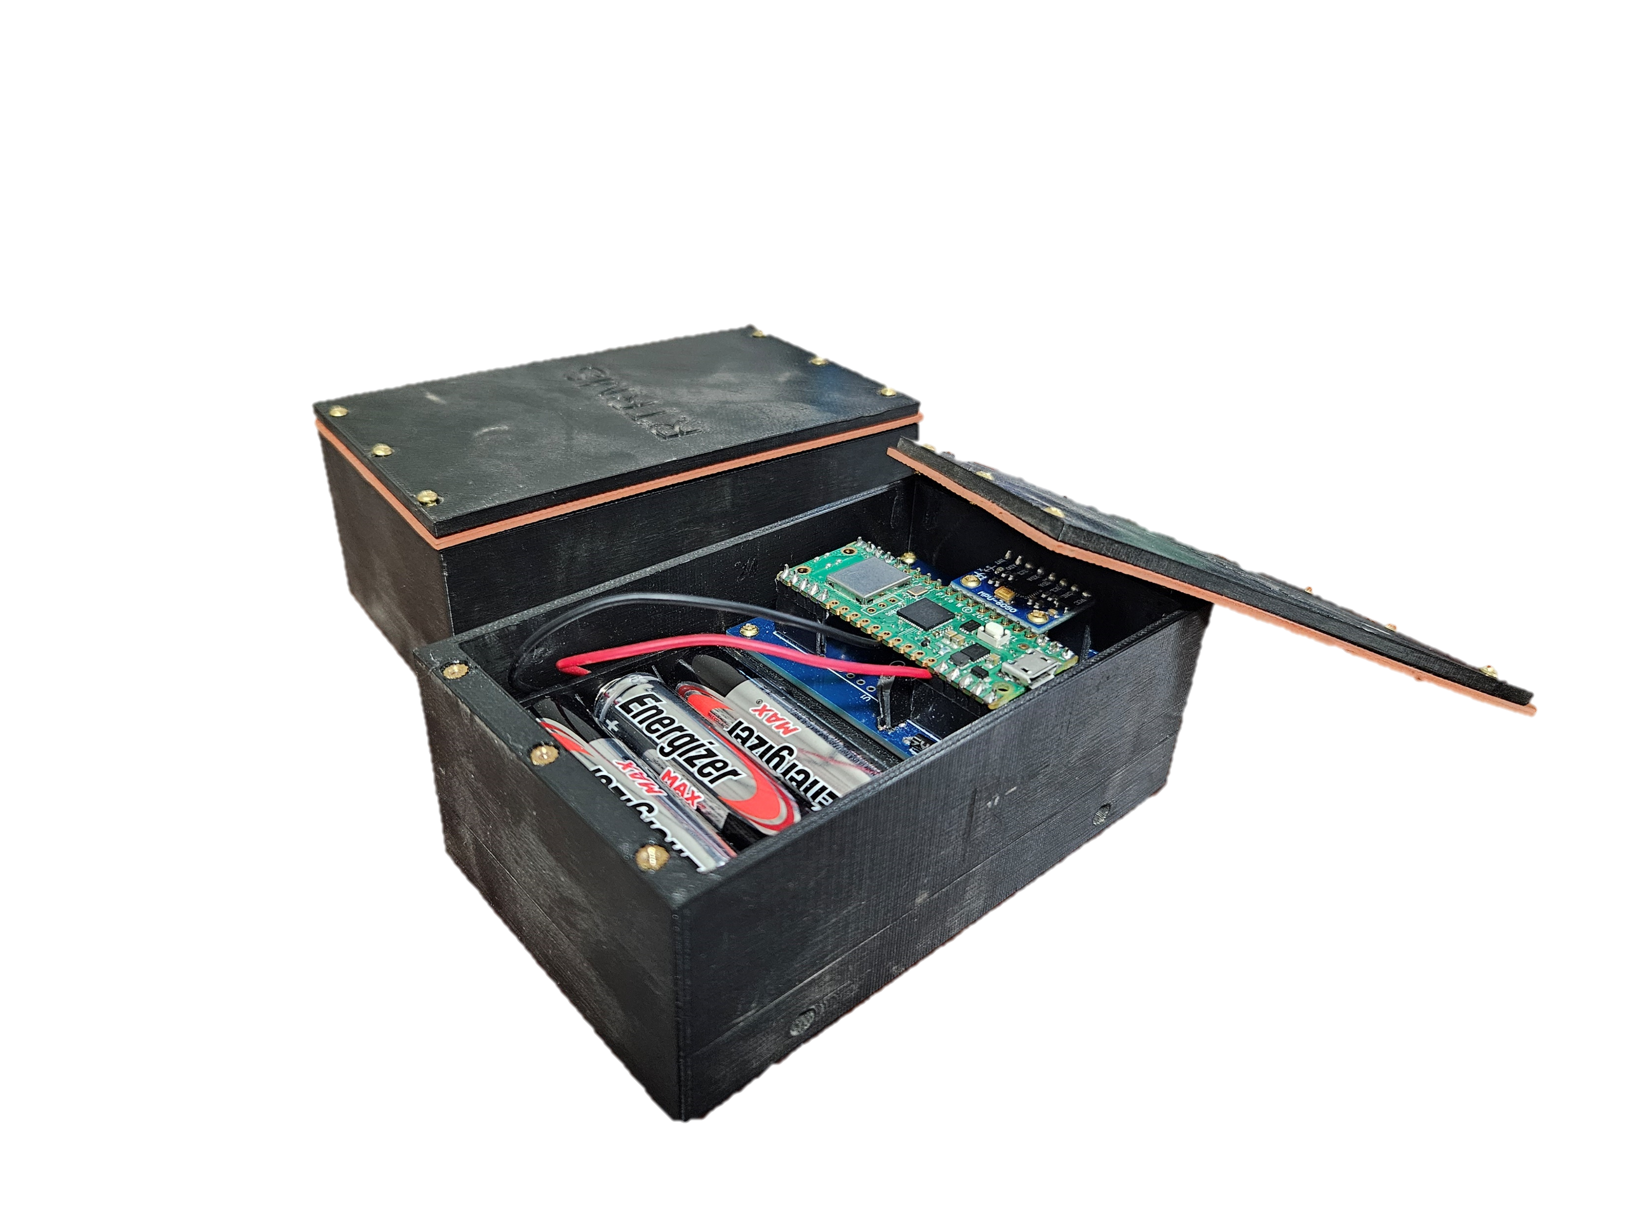
Subsystems
Central Microcontroller
Bluetooth Receivers
4G Module
Slipping Detection
4G
Pothole Detection
Bluetooth
FreeRTOS
Remote Database
GPS Module
OBD-II Module
Fig. 2: Central Box
IMU
4.5V Battery Pack
Bluetooth Transmitter
Fig. 3: Bluetooth Peripheral
Notes:
Mubashir:
Our solution has these 6 major subsystems
Slipping detection from the can bus
4G to send data using the cellular network
The pothole detection system (point to second picture)
Bluetooth system to communicate between the two boxes
FreeRTOS which is used to schedule the different functions of the project
Backend which is a remote server that will store the data that is sent from the 4G module

Slide 6
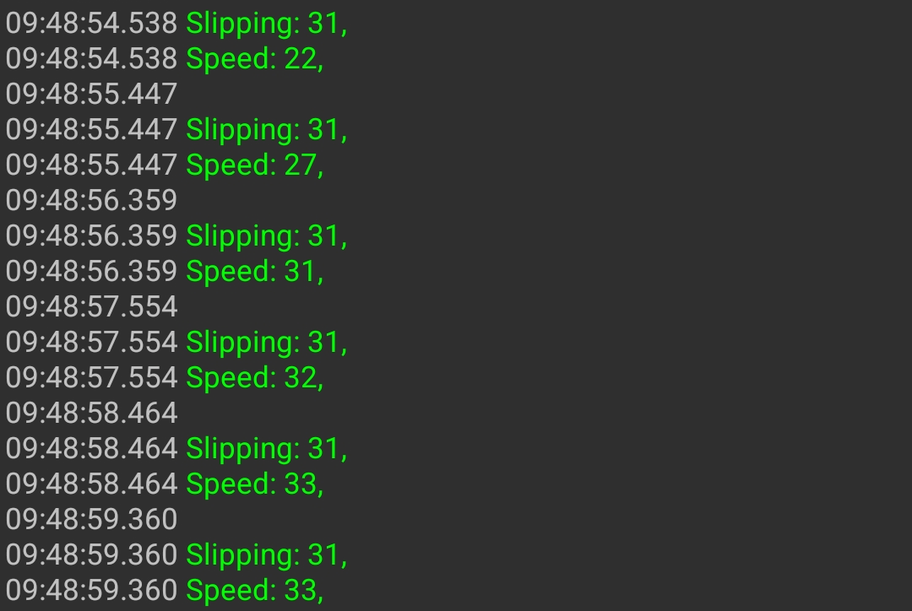
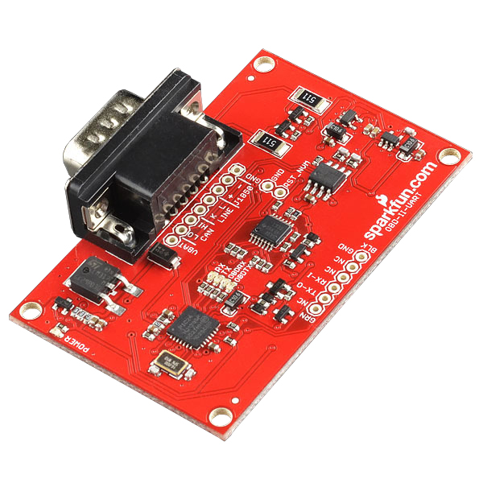
Slipping Detection
On Board Diagnostics Port (OBD-II)
CAN bus protocol
Wheel speed
Vehicle speed
Traction Control
Alternatives
Fig. 4: Output from OBD-II Module
Fig. 5: OBD-II Module
Notes:
Sarmad:
For slipping, we needed to read from a car's can bus which is located on it's on board diagnostics (OBD-II) port
A standard in all cars sold in North America since 1996, located under neath steering wheel
OBD2 port contains variety of standards, we accessed the CAN bus from it
Orignally wanted to determine slipping based on wheel speeds, but we later found the can id for the slipping light
Can bus allows each component in a vehicle to talk to each and send messages called can frames
Each component has an ID, we found the ID for vehicle speed and the state of the traction control light
When a car slips, the light would turn on and send the message with the state of the light, slipping was 10

Slide 7
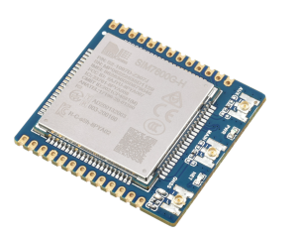
4G Module
Sim7600 4G LTE module
Connect to cellular network
Send HTTP request to backend
Alternatives
Fig. 6: 4G Module
Notes:
4G:
In order to send the collected data to the server, we decided to use a 4G module which uses the cellular network to connect to the internet and send data
When the relevant data is collected, an HTTP request is sent (same protocol used to load websites)

Slide 8
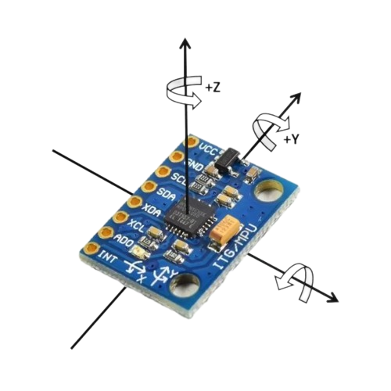
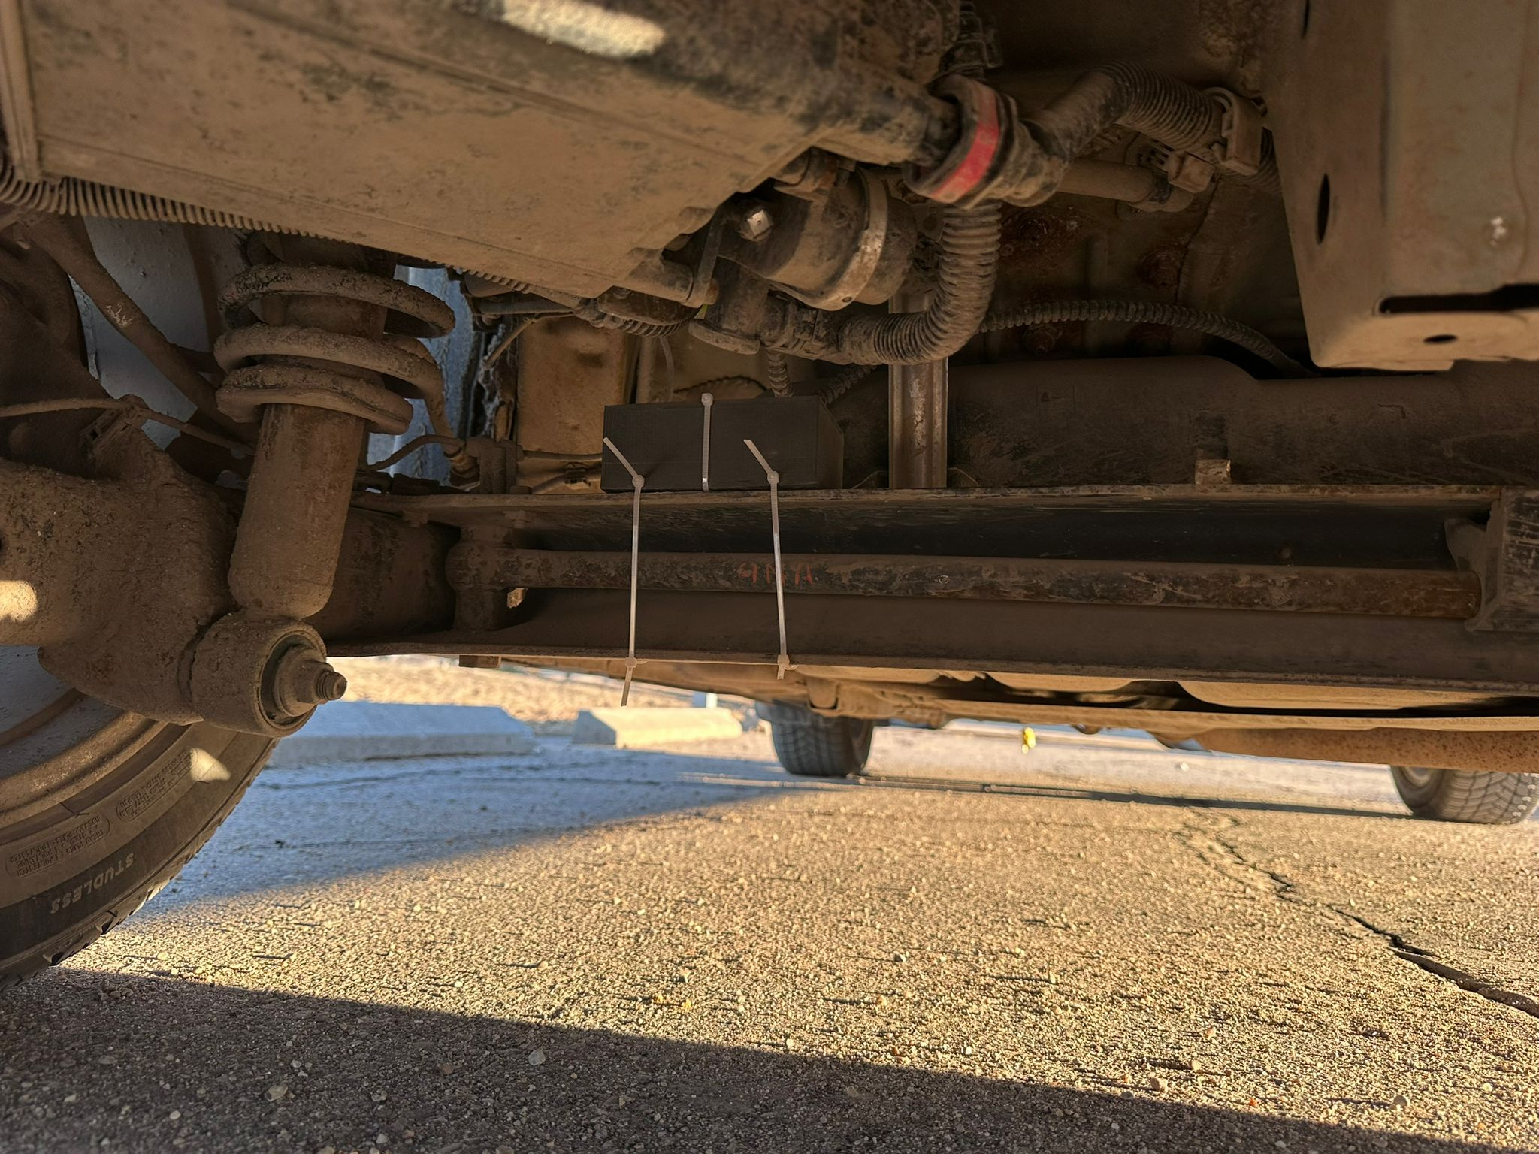
pothole detection
IMU (Inertial Measurement Unit)
Contains on-board Accelerometer
Budget friendly and commonly used
Multiple levels of potholes – Green, Yellow, Amber, Red
Use thresholding algorithm
Mounted on vehicle suspension
Alternatives
Fig. 7: MPU650 IMU
Fig. 8: Peripheral Box Mounted on Rear Suspension
Notes:
Mubashir:
Pothole detection we used an IMU (intertial measurement unit)
Powerful devices as they have multiple sensors, namely an accelerometer and gyroscope
Takes readings on 3 planes for pothole detection we use the z axis plane
Budget friendly and a commonly used part
We classify our potholes into 4 levels using thresholding algorithm
Thresholding algorithm
Each level has a set value
When we receive a reading that crosses these values, we can detect the exact pothole level

Slide 9
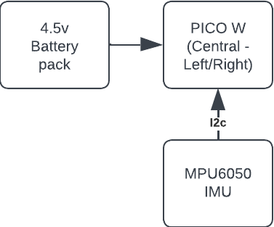
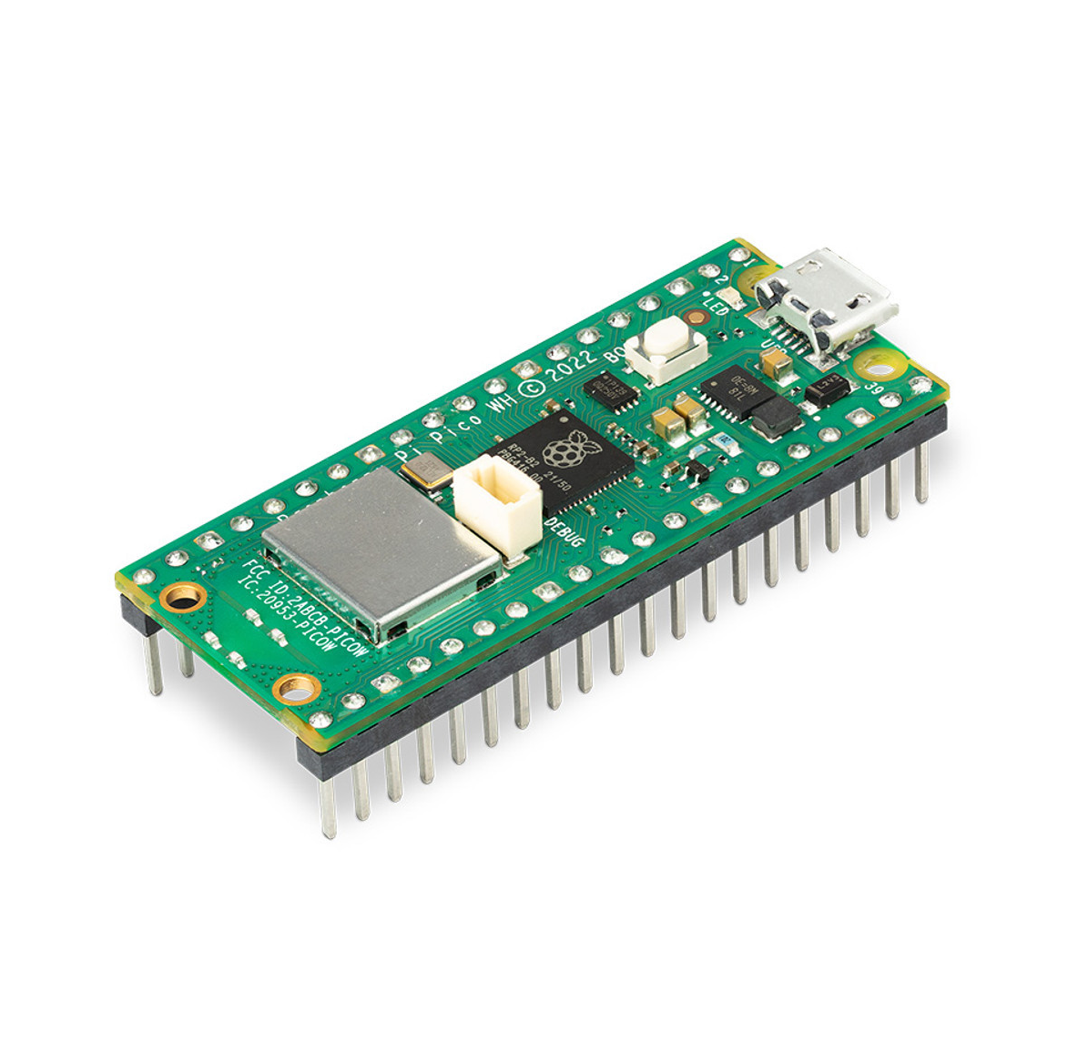
Bluetooth
BLE (Bluetooth Low Energy)
Raspberry Pi Pico W
Limited Documentation
Alternatives
Fig. 9: Block Diagram of Peripheral
Fig. 10: Pico W
Notes:
Mubashir:
Used bluetooth to communicate between the peripheral mounted on the vehicle's suspension and the main box in the vehicle
Used raspberry pi pico W
Bluetooth module was new, so we had to use more microcontrollers than was ideal
Considered Alternatives :
Wifi – 10x more power draw
Zigbee – Suitable but out of our budget

Slide 10
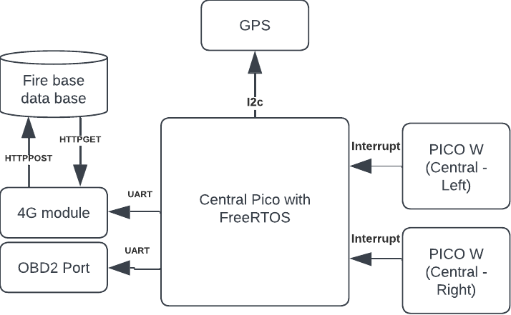
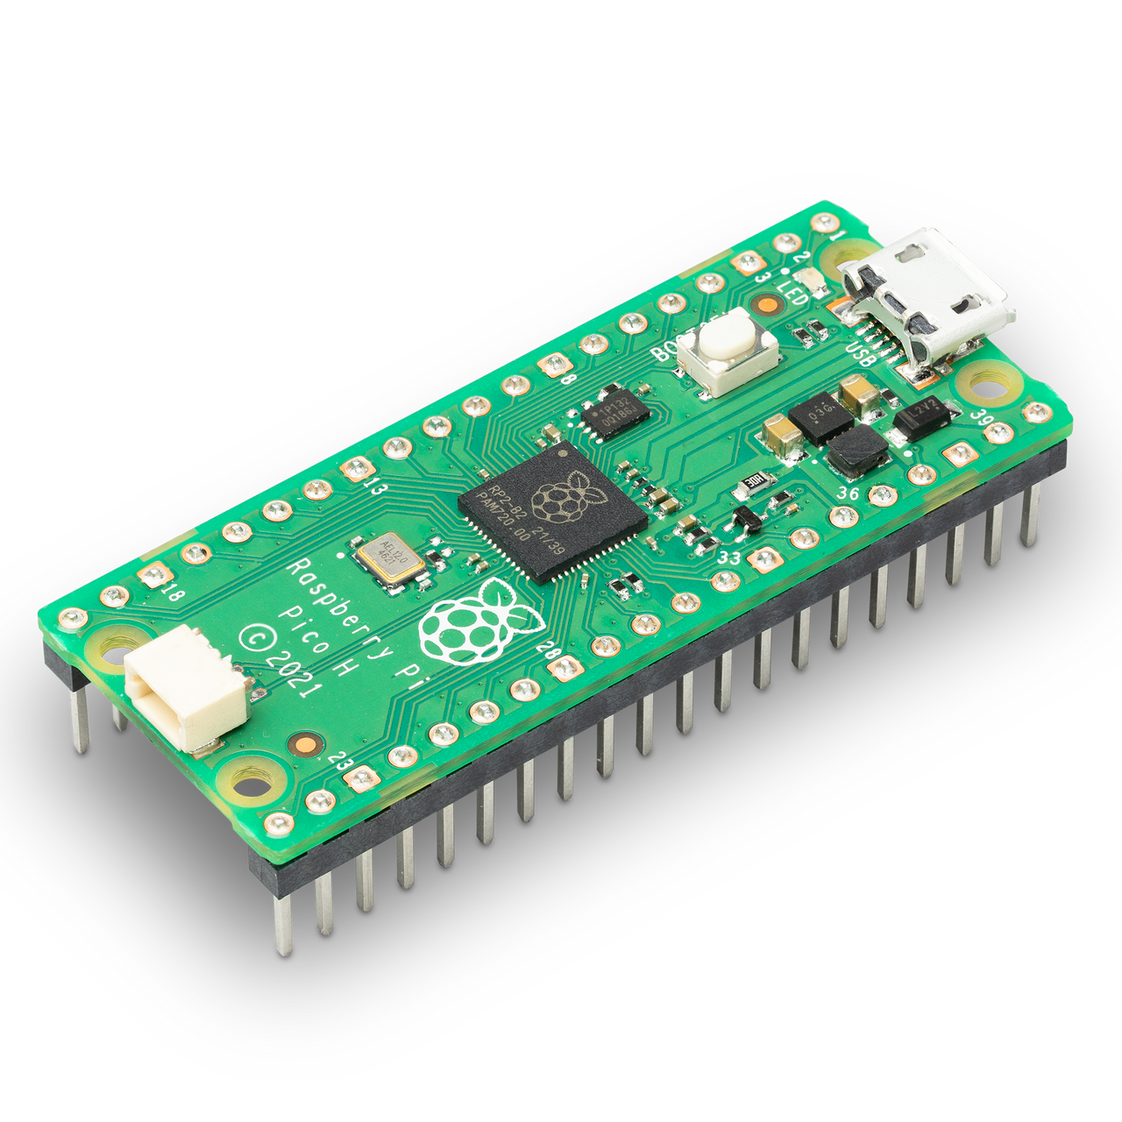
FreeRTOS
Real Time Operating System
Bundle data together
Schedule running of different components
Handle multiprocessing
Alternatives
Fig. 11: Block Diagram of Central Box
Fig. 12: Pico Microcontroller
Notes:
Sarmad:
Since we had multiple things that were happening at the same time, we decided to go with an RTOS
Allows us to schedule the running of different tasks in a simple and effective way
Also able to leverage the full power of the microcontroller (dual core)

Slide 11
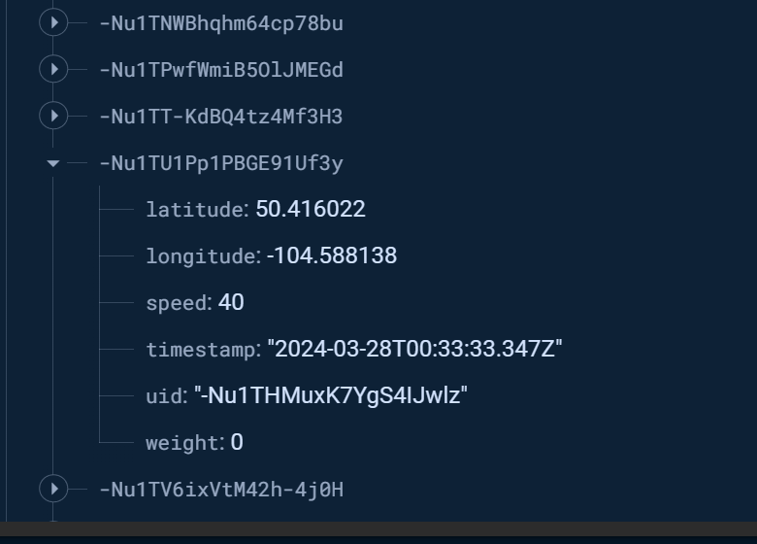
Backend
Google Firebase Realtime Database
Firebase Hosting
Google Maps API
Alternatives
Fig. 13: Firebase Database
Notes:
Sarmad:
Decided to use Google firebase
Allowed us to have a database be up and running very quickly
Took care of any security concerns
Used firebase to host a website which was able to access the database
Used google maps API to display the data

Slide 12
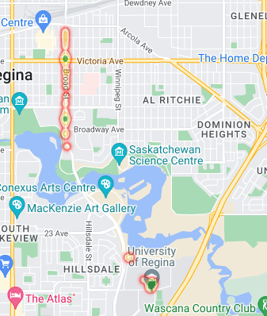
Results
Pothole detection accuracy
Slipping detection
Backend
Pothole Zone | Accuracy | Attempts | LWH (inches)
Yellow | 77% | 30 | 16" x 13" x 0.5"
Amber | 68% | 16 | 32" x 34" x 2.5"
Red | 72% | 18 | 74" x 49" x 7"
Fig. 14: Google Maps Showing Potholes
Fig. 15: Pothole Test Results
Notes:
Mubashir:
2 vehicles were used to collect this data
Different suspensions
Different weight distribution
Accuracy is based on the correct level not whether a pothole has been driven over
Challenges faced
Various road conditions, limited control of testing environment
We were not able to achieve an accuracy of 80%
Originally, we set out to determine slipping through wheel speed, once we found the can ID, we were able to have a 100% accuracy for slipping detection
Back End
Successfully store and visualize our data

Slide 13
budget
Central | Qty. | Cost
Pico W | 2 | $ 17.10
Pico | 1 | $ 9.95
GPS Module | 1 | $ 58.17
OBD-II Module | 1 | $ 77.12
4G Module | 1 | $ 78.55
PCB | 5 | $ 49.30
Enclosure | 1 | $ 2.65
Total: |  | $ 292.84
Peripheral | Qty. | Cost
Pico W | 2 | $ 17.10
IMU | 2 | $ 10.34
Zener Diode | 2 | $ 0.40
PCB | 10 | $ 20.76
Batteries | 36 | $ 26.98
Enclosure | 1 | $ 3.03
Gasket | 5 | $ 24.54
Total |  | $ 103.15
Fig. 16: Central Board Budget
Fig. 17: Peripheral Board Budget
Notes:
Mubashir Hussain
Budget:
Show cost
Prototype Is generally more costly then final a product
Does not include labour cost
This does not include economies of scale

Slide 14
Conclusions
Core objectives met
Pothole detection
Road conditions
Future improvements
Design changes
Further testing
More data
Notes:
Sarmad:
We were able to meet all of our core objectives in the project
We were able to detect potholes using accellerometers
Able to detect road conditions using a car's can bus
Were able to send data via 4G and show it on a website
Future improvements
Were we to continue the project in the future, there would some key changes
Power peripherals from car battery
Mount IMU on front wheels
Testing on more standardized potholes
Further increase reliability (coding) of the system
Reduce the amount of microcontrollers
Change OBD2 module with can bus module

Slide 15
Acknowledgements
Irfan Al-Anbagi (Project Advisor)
Doug Wagner (Supervisor)
Paul Laforge (Supervisor)
Vikas Ravada (Senior Engineer, Traffic)
Mathew Yee (Project Engineer, Roadways Preservation)

Slide 16

THANK YOU
Please Come See Our Booth in ED114

